Slide 1

Yelp API Project
Vaneeza Ahmad & Nate Tsegaw

Slide 2
Open a flower shop in the area of
Leesburg, VA or Silver Spring, MD?

Slide 3
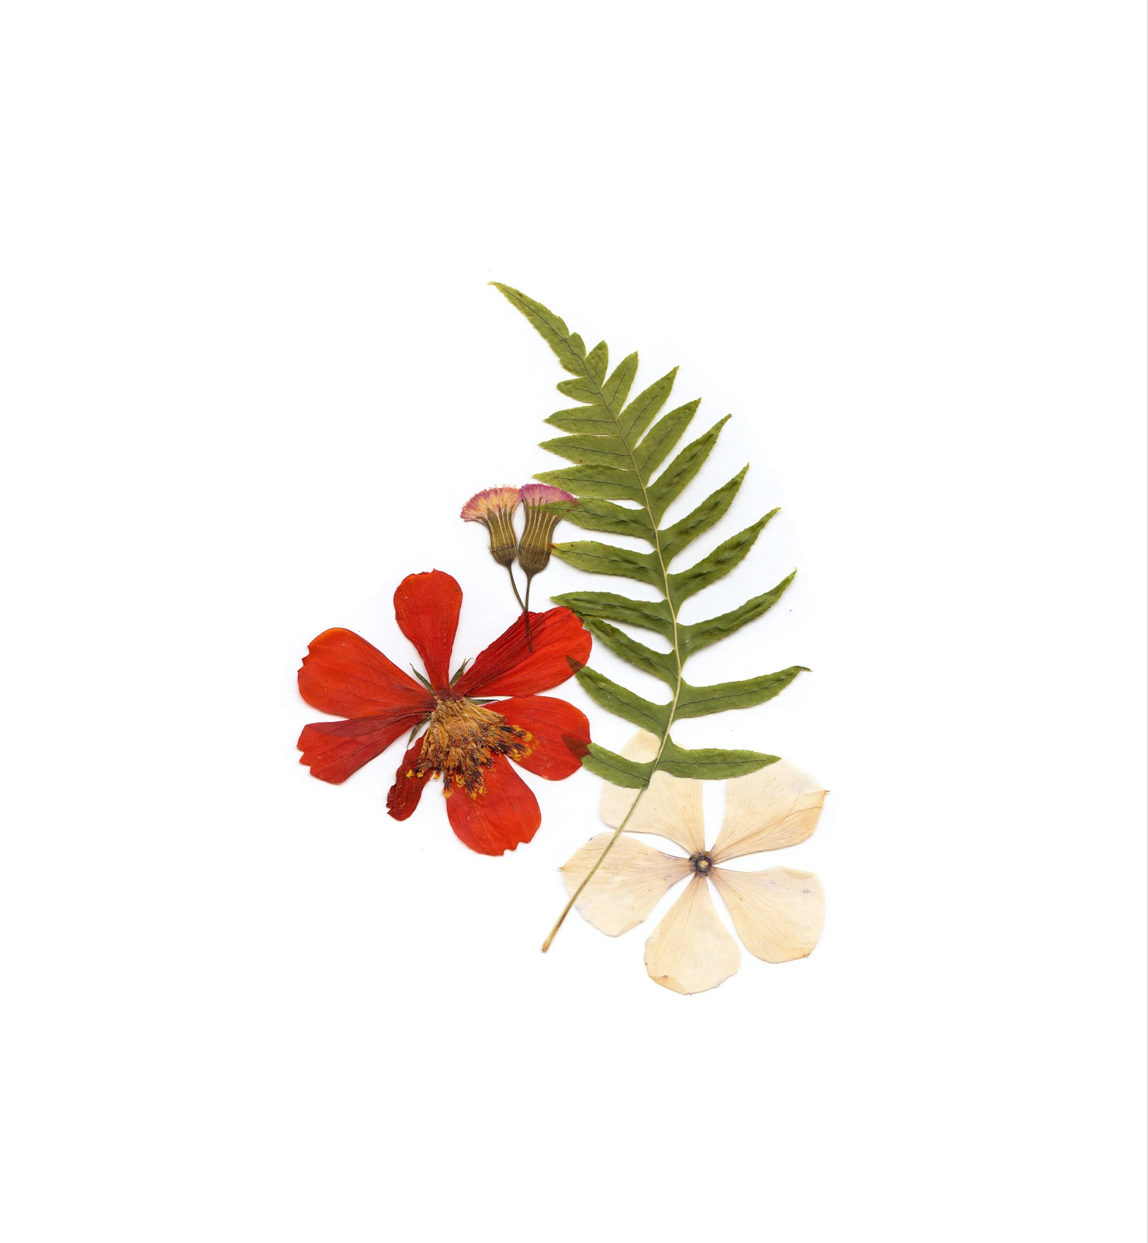
Leesburg, VA

Slide 4

Who has the most flower shops?

Slide 5
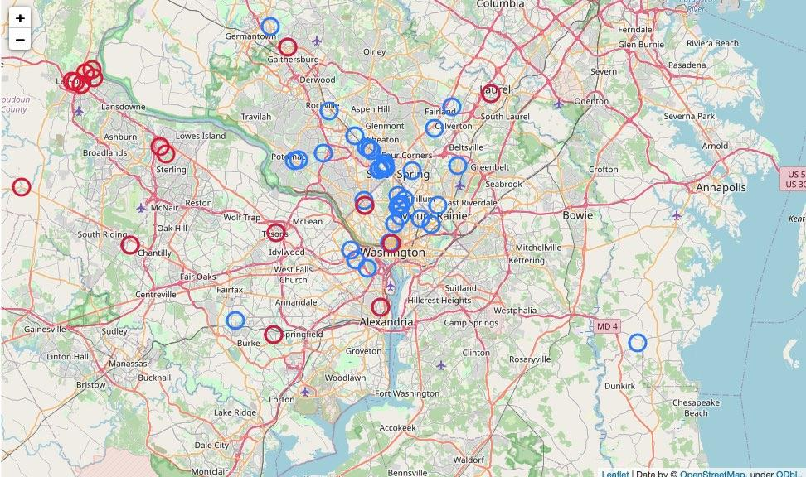
More flower shops that service the Silver Spring area
Leesburg area flower shops are more spread out
O = Leesburg
O = Silver Spring

Slide 6

How are flower shops rated in each area?

Slide 7
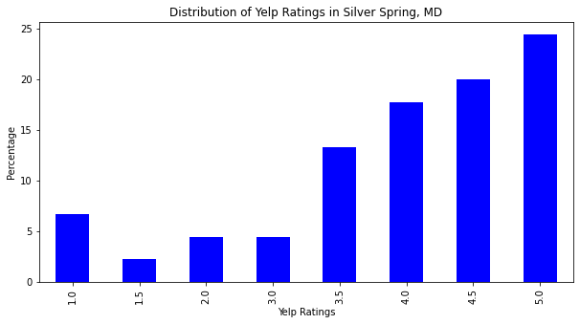
Ratings all across the board.
Most shops located
within 3.5 and greater range.
Notes:
Data driven observation #1

Slide 8
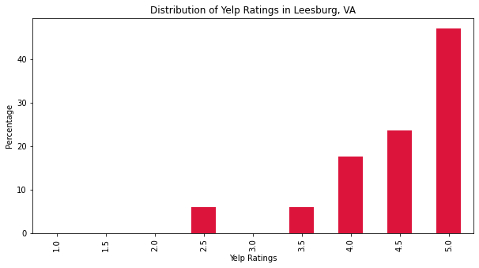
Most shops are within range of 3.5-stars and greater.
Over 40% of flower shops have a 5-star rating.
Notes:
Data driven observation #1

Slide 9

Is there a connection between rating and review count?

Slide 10
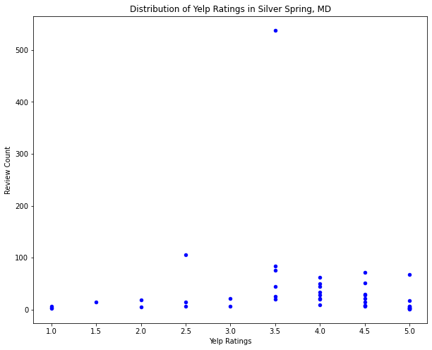
Very weak correlation between both variables
Notes:
Data driven observation #1

Slide 11
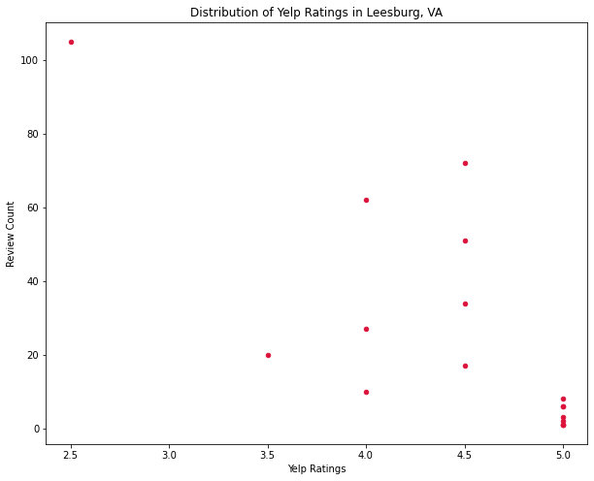
Very weak correlation between both variables.
Notes:
Data driven observation #1

Slide 12

What is our target demographic?

Slide 13
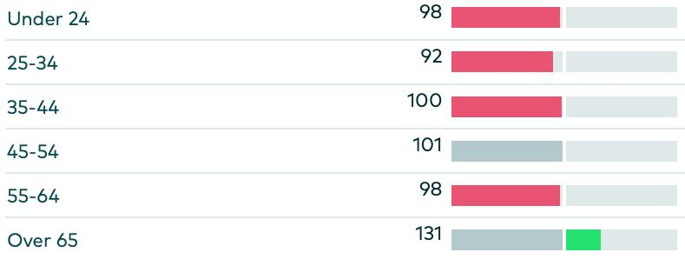
Age
Data from Numerator
Persons over 65
Silver Spring: 10.4%
Leesburg: 8.5%
Data from US Census (SS/LB)

Slide 14
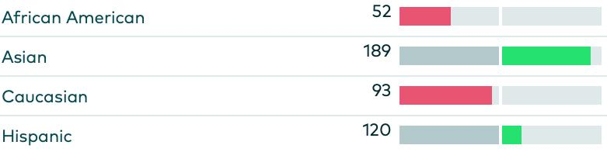
Race
Data from Numerator
Asian & Hispanic Populations
Silver Spring: 7.4%, 28%
Leesburg: 8.1%, 17.7%
Data from US Census (SS/LB)
Notes:
Data driven observation #1

Slide 15
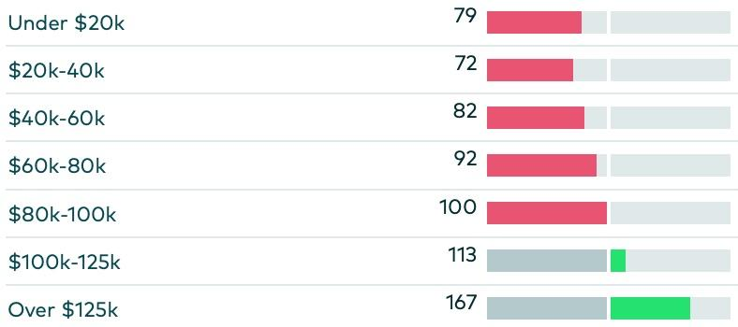
Income
Median Household Income
Silver Spring: $83, 782
Leesburg: $114,444
Data from Numerator
Data from US Census (SS/LB)
Notes:
Data driven observation #1

Slide 16
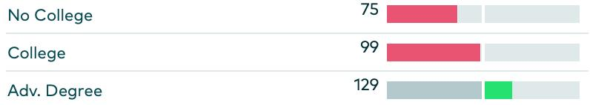
Education
Data from Numerator
Bachelor’s or higher attained
Silver Spring: 54.9%
Leesburg: 54.2%
Data from US Census (SS/LB)
Notes:
Data driven observation #1

Slide 17
Why Leesburg?
There are less flower shops
Shops are spread out farther geographically
Slightly larger Asian population
Median household is much larger

Slide 18

Further Analysis?
More in depth filtering of data (overlap, wrong business type, etc.)
Credibility of Numerator data is questionable
Misc. Yelp API quirks
Data on couples by city. (70% of all sales on Valentines day)

Slide 19

Thank You!

